Slide 1


http://www.comp.nus.edu.sg/~cs2100/
Recitation-4
MIPS – 3 & ISA
L9 and L10 videos
Prabhu NATARAJAN

Slide 2

Agenda
MIPS Revision
Quiz Questions

Slide 3
REVISION

Slide 4
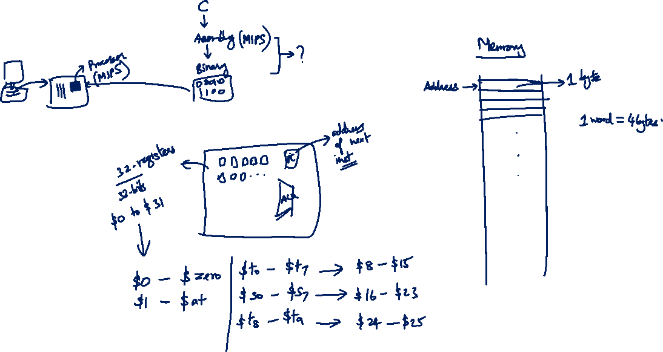
MIPS Revision

Slide 5
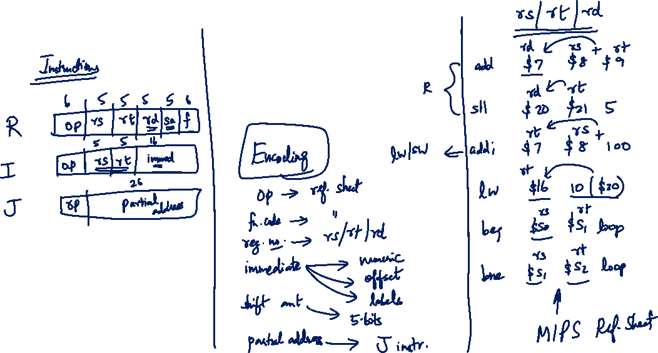
MIPS Revision
Notes:
rs is easy to remember: "source" register.
rd is easy too: "destination" register (result storage in R type).
rt is the tricky one because it sometimes acts as a source and sometimes as a destination. Holds the second input operand (or destination in I-type instructions)
rs in sll or srl is always set to 0.
rs = "source" (first operand)
rd = "destination" (result register in R-type)
rt = "the tricky one"
In R-type, rt is just a second operand.
In I-type (loads, stores, immediate ops), rt is the destination.
In stores and branches, rt is a source.
Mnemonic:
R-type → rd gets the result I-type → rt gets the result (except in sw and branches)

Slide 6
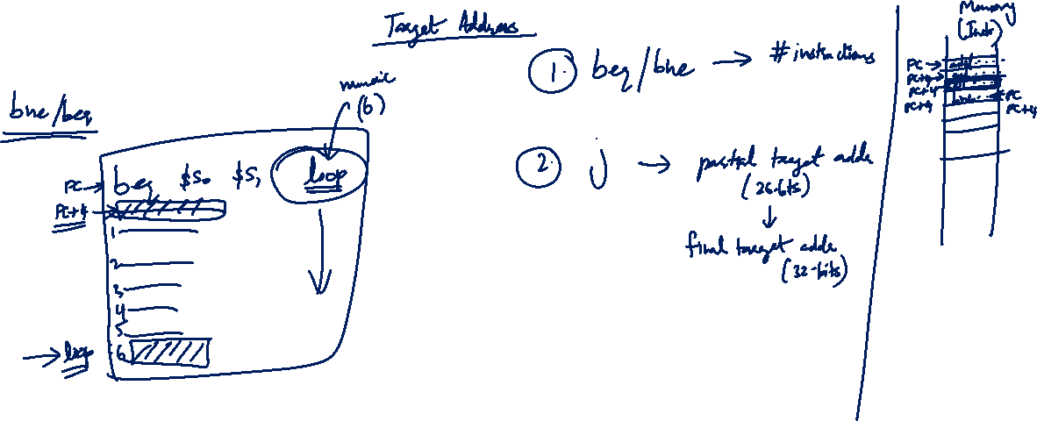
MIPS Revision

Slide 7
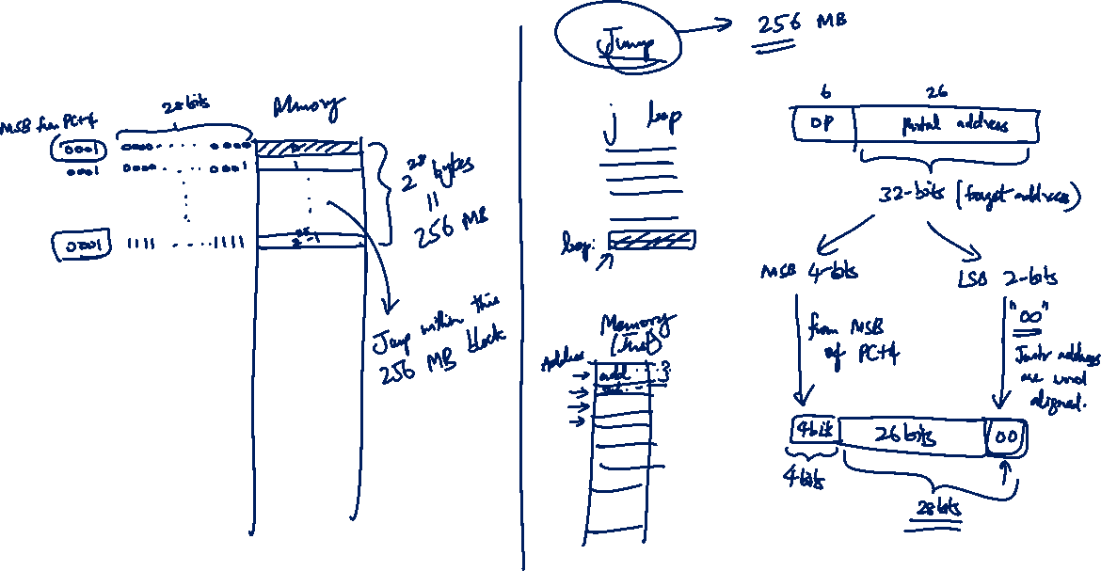
MIPS Revision

Slide 8
2. MIPS Encoding: Basics
Each MIPS instruction has a fixed-length of 32 bits
➔ All relevant information for an operation must be encoded with these bits!
Additional challenge:
To reduce the complexity of processor design, the instruction encodings should be as regular as possible
➔ Small number of formats, i.e. as few variations as possible

Slide 9

3. MIPS Instruction Classification
Instructions are classified according to their operands:
➔ Instructions with same operand types have same encoding
R-format (Register format: op $r1, $r2, $r3)
Instructions which use 2 source registers and 1 destination register
e.g. add, sub, and, or, nor, slt, etc
I-format (Immediate format: op $r1, $r2, Immd)
e.g. addi, andi, ori, slti, lw, sw, beq, bne, etc.
J-format (Jump format: op Immd)
j instruction uses only one immediate value
Instructions which use 1 source register, 1 immediate value and 1 destination register
Special cases: srl, sll, etc.

Slide 10
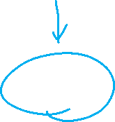
5. R-Format (1/2)
Define fields with the following number of bits each:
6 + 5 + 5 + 5 + 5 + 6 = 32 bits
6
5
5
5
5
6
Each field has a name:
opcode
rs
rt
rd
shamt
funct
Each field is an independent 5- or 6-bit unsigned integer
A 5-bit field can represent any number 0 – 31
A 6-bit field can represent any number 0 – 63

Slide 11

5.1 R-Format: Example (1/3)
MIPS instruction
add $8, $9, $10
R-Format Fields | Value | Remarks
opcode | 0 | (textbook pg 94 - 101)
funct | 32 | (textbook pg 94 - 101)
rd | 8 | (destination register)
rs | 9 | (first operand)
rt | 10 | (second operand)
shamt | 0 | (not a shift instruction)

Slide 12

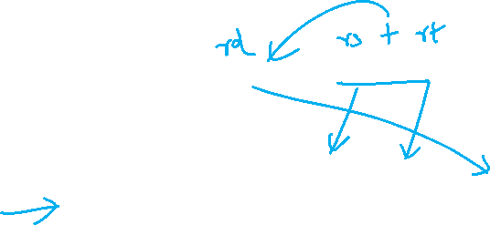
5.1 R-Format: Example (2/3)
MIPS instruction
add $8, $9, $10
Note the ordering of the 3 registers
Field representation in decimal:
opcode
rs
rt
rd
shamt
funct
0
9
10
8
0
32
Field representation in binary:
000000
01001
01010
01000
00000
100000
Split into 4-bit groups for hexadecimal conversion:
0000
0001
0010
1010
0100
0000
0010
0000
0₁₆
1₁₆
2₁₆
A₁₆
4₁₆
0₁₆
2₁₆
0₁₆

Slide 13

5.1 R-Format: Example (3/3)
MIPS instruction
sll $8, $9, 4
Note the placement of the source register
Field representation in decimal:
opcode
rs
rt
rd
shamt
funct
0
0
9
8
4
0
Field representation in binary:
000000
00000
01001
01000
00100
000000
Split into 4-bit groups for hexadecimal conversion:
0000
0000
0000
1001
0100
0001
0000
0000
0₁₆
0₁₆
0₁₆
9₁₆
4₁₆
1₁₆
0₁₆
0₁₆

Slide 14
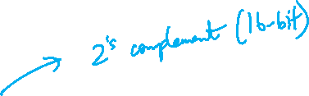
6. I-format (2/4)
Define fields with the following number of bits each:
6 + 5 + 5 + 16 = 32 bits
6
5
5
16
Again, each field has a name:
opcode
rs
rt
immediate
Only one field is inconsistent with R-format.
opcode, rs, and rt are still in the same locations.

Slide 15
6.1 I-format: Example (1/2)
MIPS instruction
addi $21, $22, -50
I-Format Fields | Value | Remarks
opcode | 8 | (textbook pg 94 - 101)
rs | 22 | (the only source register)
rt | 21 | (target register)
immediate | -50 | (in base 10)

Slide 16
6.1 I-format: Example (2/2)
MIPS instruction
addi $21, $22, -50
Field representation in decimal:
8
22
21
-50
Field representation in binary:
001000
10110
10101
1111111111001110
Hexadecimal representation of instruction:
2 2 D 5 F F C E₁₆

Slide 17
6.2 Try It Yourself #2
MIPS instruction
lw $9, 12($8)
Field representation in decimal:
opcode
rs
rt
immediate
35
8
9
12
Field representation in binary:
100011
01000
01001
0000000000001100
Hexadecimal representation of instruction:
8 D 0 9 0 0 0 C₁₆


Slide 18
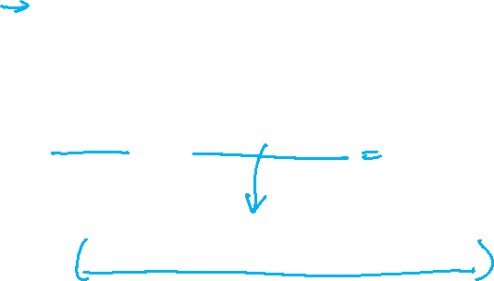
6.4 Branch: PC-Relative Addressing (5/5)
Branch calculation:
Observations:
immediate field specifies the number of words to jump, which is the same as the number of instructions to “skip over”
immediate field can be positive or negative
Due to hardware design, add immediate to (PC+4), not to PC (more in later topic)
If the branch is not taken:
PC = PC + 4
(PC + 4 is address of next instruction)
If the branch is taken:
PC = (PC + 4) + (immediate × 4)

Slide 19
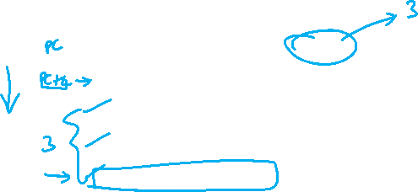
6.5 Branch: Example (1/3)
Loop: beq $9, $0, End # rlt addr: 0
add $8, $8, $10 # rlt addr: 4
addi $9, $9, -1 # rlt addr: 8
j Loop # rlt addr: 12
End: # rlt addr: 16
beq is an I-Format instruction ➔
I-Format Fields | Value | Remarks
opcode | 4
rs | 9 | (first operand)
rt | 0 | (second operand)
immediate | ??? | (in base 10)

Slide 20
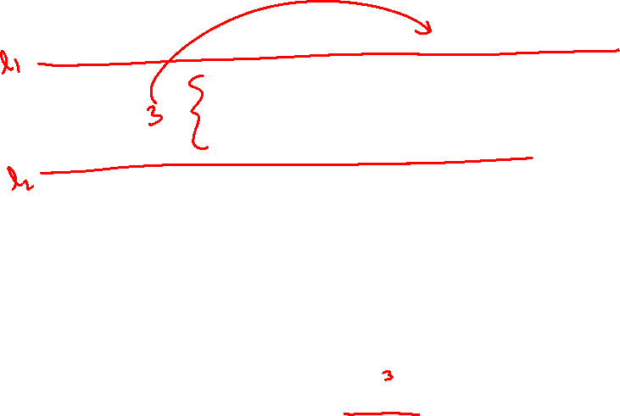
6.5 Branch: Example (2/3)
Loop: beq $9, $0, End # rlt addr: 0
add $8, $8, $10 # rlt addr: 4
addi $9, $9, -1 # rlt addr: 8
j Loop # rlt addr: 12
End: # rlt addr: 16
immediate field:
Number of instructions to add to (or subtract from) the PC, starting at the instruction following the branch
In beq case, immediate = 3
End = (PC + 4) + (immediate × 4)

Slide 21
6.5 Branch: Example (3/3)
Loop: beq $9, $0, End # rlt addr: 0
add $8, $8, $10 # rlt addr: 4
addi $9, $9, -1 # rlt addr: 8
j Loop # rlt addr: 12
End: # rlt addr: 16
Field representation in decimal:
opcode
rs
rt
immediate
4
9
0
3
Field representation in binary:
000100
01001
00000
0000000000000011

Slide 22
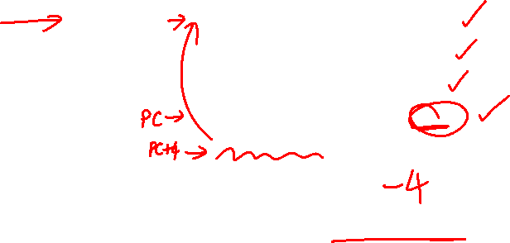
6.6 Try It Yourself #3
Loop: beq $9, $0, End # rlt addr: 0
add $8, $8, $10 # rlt addr: 4
addi $9, $9, -1 # rlt addr: 8
beq $0, $0, Loop # rlt addr: 12
End: # rlt addr: 16
What would be the immediate value for the second beq instruction?
Answer: – 4


Slide 23
7. J-Format (2/5)
Define fields of the following number of bits each:
6 bits
26 bits
As usual, each field has a name:
opcode
target address
Keep opcode field identical to R-format and I-format for consistency
Combine all other fields to make room for larger target address

Slide 24
7. J-Format (3/5)
We can only specify 26 bits of 32-bit address
Optimization:
Just like with branches, jumps will only jump to word-aligned addresses, so last two bits are always 00
So, let’s assume the address ends with ’00’ and leave them out
➔ Now we can specify 28 bits of 32-bit address

Slide 25
7. J-Format (4/5)
Where do we get the other 4 bits?
MIPS choose to take the 4 most significant bits from PC+4 (the next instruction after the jump instruction)
➔ This means that we cannot jump to anywhere in memory, but it should be sufficient most of the time
Question:
What is the maximum jump range?
256MB boundary
Special instruction if the program straddles 256MB boundary
Look up jr instruction if you are interested
Target address is specified through a register

Slide 26

7.1 J-Format: Example
Loop: beq $9, $0, End # addr: 8
add $8, $8, $10 # addr: 12
addi $9, $9, -1 # addr: 16
j Loop # addr: 20
End: # addr: 24
jump target
PC
PC
0000………………………..10100
Check your understanding by constructing the new PC value
Address to jump to
0000………………………..01000
immediate =2 (26 bits)
opcode
target address
000010
00000000000000000000000010

Slide 27

3.5 Fixed Length Instructions: Encoding (1/4)
Fixed length instruction presents a much more interesting challenge:
Q: How to fit multiple sets of instruction types into same (limited) number of bits?
A: Work with the most constrained instruction types first
Expanding Opcode scheme:
The opcode has variable lengths for different instructions.
A good way to maximize the instruction bits.

Slide 28
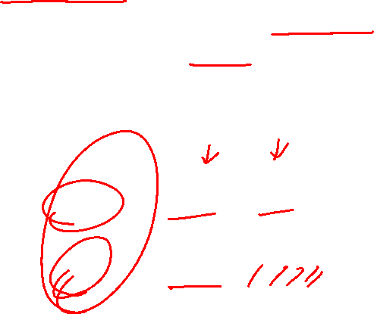
3.5 Fixed Length Instructions: Encoding (2/4)
Example:
16-bit fixed length instructions, with 2 types of instructions
Type-A: 2 operands, each operand is 5-bit
Type-B: 1 operand of 5-bit
First Attempt:
Fixed length Opcode
Problem:
Wasted bits in Type-B instructions
Maximum total number of instructions is 2⁶ or 64.
opcode
operand
operand
Type-A
6 bits
5 bits
5 bits
opcode
operand
unused
Type-B
6 bits
5 bits
5 bits

Slide 29
3.5 Fixed Length Instructions: Encoding (3/4)
Use expanding opcode scheme:
Extend the opcode for type-B instructions to 11 bits
➔ No wasted bits and result in a larger instruction set
opcode
operand
operand
Second Attempt:
Expanding Opcode
Type-A
6 bits
5 bits
5 bits
opcode
operand
Type-B
11 bits
5 bits
Questions:
How do we distinguish between Type-A and Type-B?
How many different instructions do we really have?
Notes:
Wasting bits in instruction encoding leads to higher memory usage, slower execution, and reduced scalability. Good instruction set designs try to minimize wasted bits while keeping the format simple and extensible.

Slide 30
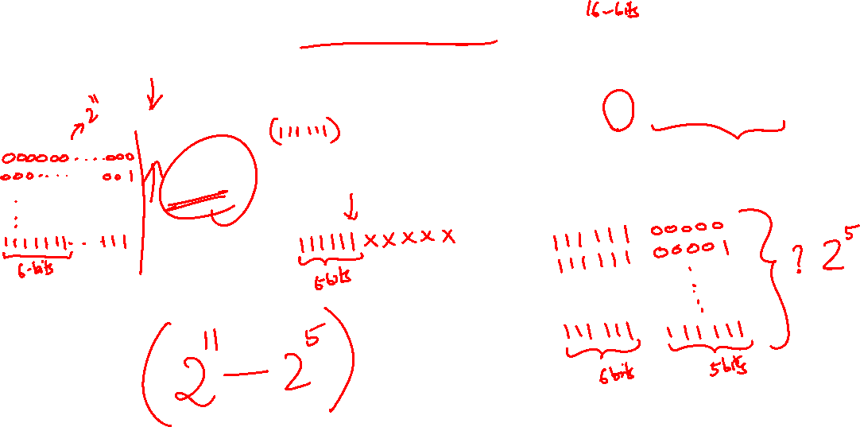
3.5 Fixed Length Instructions: Encoding (4/4)
What is the maximum number of instructions?
opcode
operand
operand
Answer:
1 + (2⁶ –1) × 2⁵
= 1 + 63×32
= 2017
Type-A
6 bits
5 bits
5 bits
opcode
operand
Type-B
11 bits
5 bits
Reasoning:
For every 6-bit prefix (front-part) given to Type-B, we get 2⁵ unique patterns, e.g. [111111]XXXXX
So, we should minimize Type-A instruction and give as many 6-bit prefixes as possible to Type-B
➔ 1 Type-A instruction, 2⁶ – 1 prefixes for Type-B

Slide 31
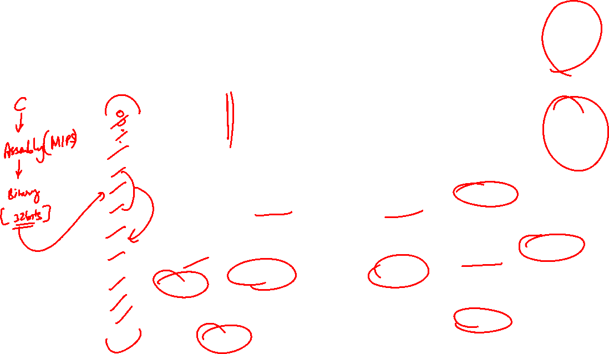
Datapath & Control
Instruction
Memory
PC
Add
MUX
Instruction
4
Left Shift 2-bit
Add
Address
PCSrc
Control
Branch
Inst [31:26]
Inst [25:21]
5
RR1
RD1
Inst [20:16]
5
RR2
is0?
MemWrite
Registers
ALUSrc
ALU
opcode
31:26
rs
25:21
rt
20:16
rd
15:11
shamt
10:6
5
funct
5:0
WR
ALU
result
MUX
Address
RD2
MUX
WD
Data
Memory
MemToReg
Inst [15:11]
4
RegWrite
ALUcontrol
Read
Data
MUX
RegDst
Write
Data
Inst [15:0]
Sign Extend
Inst [5:0]
MemRead
ALUop
ALU Control

Slide 32
Past Midterm/Exam Questions (1/2)
A certain machine has 12-bit instructions and 4-bit addresses. Some instructions have one address and others have two. Both types of instructions exist in the machine.
What is the maximum number of instructions with one address?
15
16
240
256
None of the above
Answer: (c)


Slide 33
Past Midterm/Exam Questions (2/2)
A certain machine has 12-bit instructions and 4-bit addresses. Some instructions have one address and others have two. Both types of instructions exist in the machine.
What is the minimum total number of instructions, assuming the encoding space is completely utilized (that is, no more instructions can be accommodated)?
31
32
48
256
None of the above
Answer: (a)


Slide 34
quiz solution

Slide 35
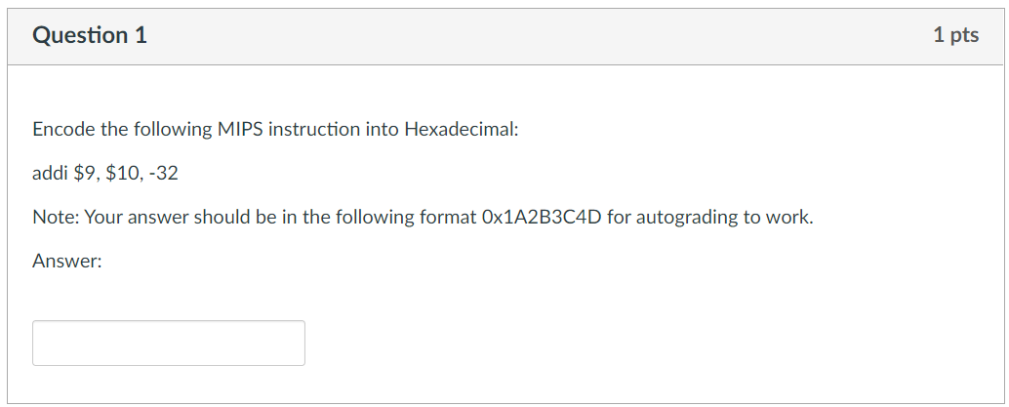
Week-4 MIPS

Slide 36


Week-4 MIPS
rt
rs
opcode
rs
rt
immediate
001000
01010
01001
1111 1111 1110 0000
-32 = -(0b0000 0000 0010 0000_{2s})
= 0b1111 1111 1110 0000_{2s}
Encoding = 0b0010 0001 0100 1001 1111 1111 1110 0000
= 0x2149FFE0

Slide 37
Week-4 MIPS
0x2149FFE0

Slide 38
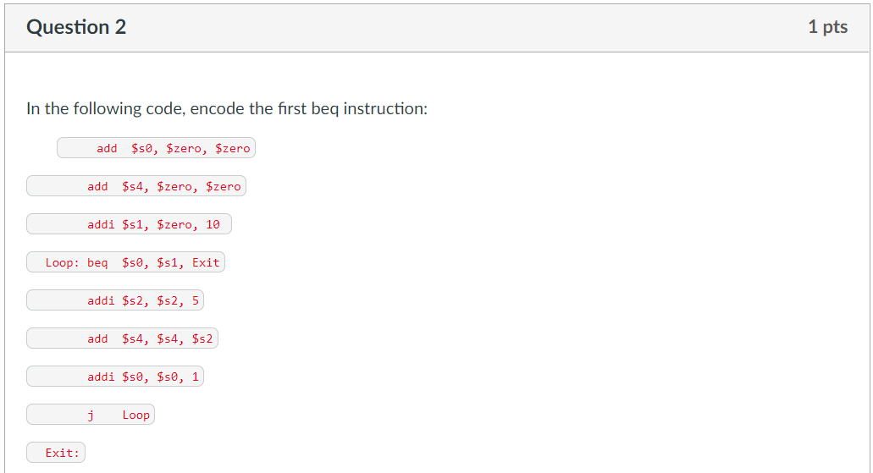

Week-4 MIPS
4 instructions

Slide 39

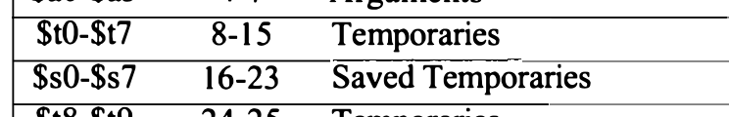
Week-4 MIPS
rs
rt
$s0 = 16, $s1=17
opcode
rs
rt
immediate
000100
10000
10001
0000 0000 0000 0100
Encoding: 0b000100 10000 10001 0000 0000 0000 0100
= 0b0001 0010 0001 0001 0000 0000 0000 0100
= 0x12110004

Slide 40
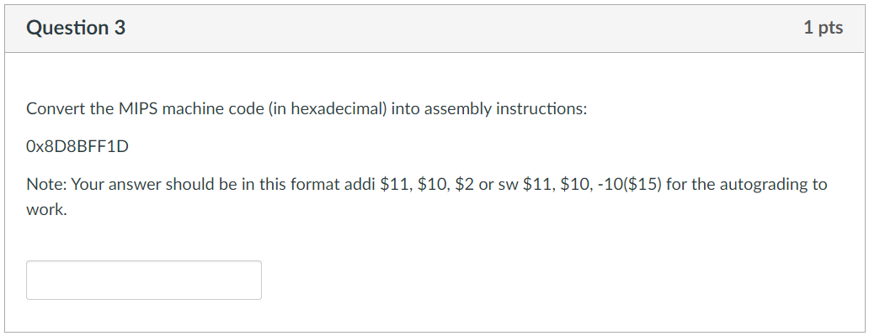
Week-4 MIPS
Notes:
The 2’s complement binary 1111 1111 0001 1101 is negative since the MSB is 1. Converting it by inverting the bits and adding 1 gives 227, so the final decimal value is -227.

Slide 41

Week-4 MIPS
= 0b1000 1101 1000 1011 1111 1111 0001 1101
= 0b100011 01 1000 1011 1111 1111 0001 1101
Opcode = 0x23 = lw
opcode
rs
rt
immediate
0b100011 01100 01011 1111 1111 0001 1101
= lw $11, $12, -227
= lw $11, -227($12)
Notes:
The 2’s complement binary 1111 1111 0001 1101 is negative since the MSB is 1. Converting it by inverting the bits and adding 1 gives 227, so the final decimal value is -227.

Slide 42
Week-4 MIPS
lw $12, -227($11)

Slide 43
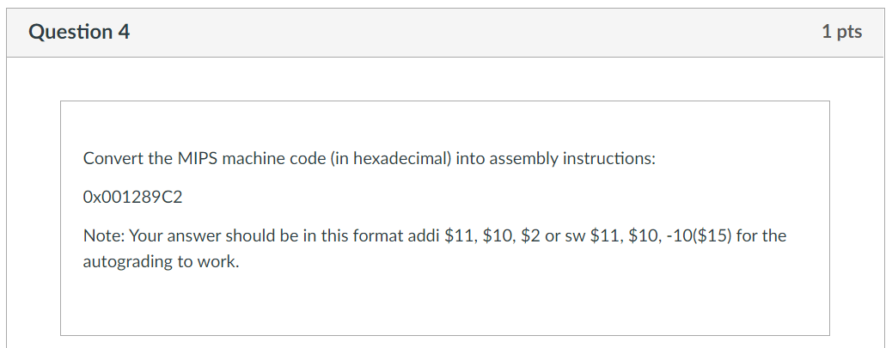
Week-4 MIPS

Slide 44

Week-4 MIPS
= 0b0000 0000 0001 0010 1000 1001 1100 0010
= 0b000000 00 0001 0010 1000 1001 1100 0010
Opcode = 0x00 = R-Type
funct = 0b000010 = 0x2 = srl
= 0b000000 00000 10010 10001 00111 000010
srl $17, $18, 7

Slide 45
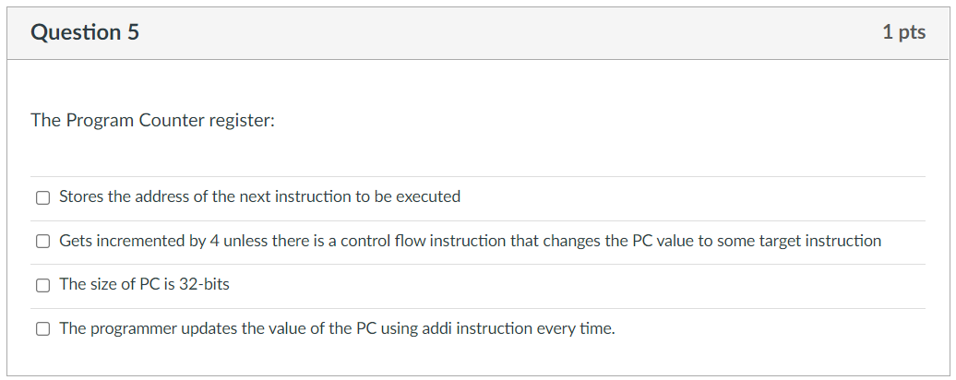

Week-4 MIPS

Slide 46
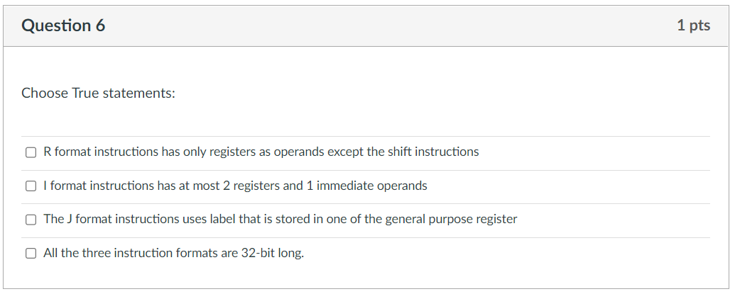

Week-4 MIPS

Slide 47
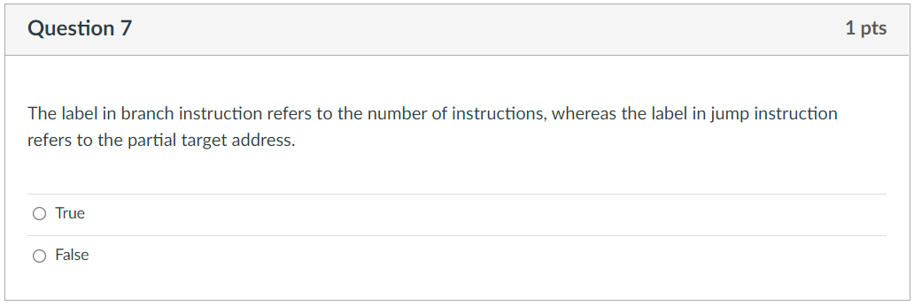

Week-4 MIPS

Slide 48
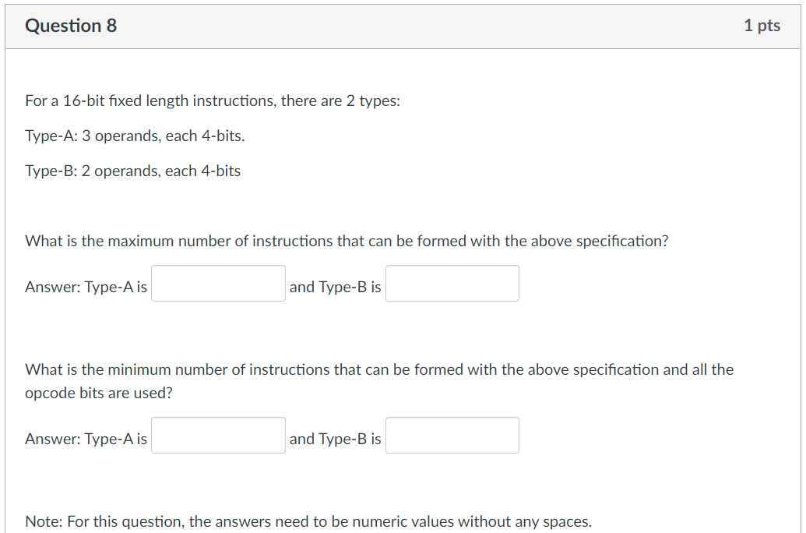
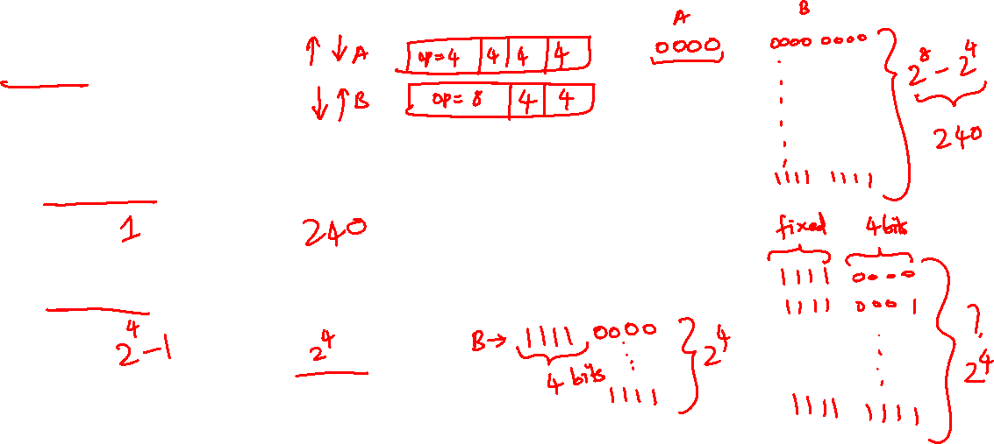
Week-4 MIPS

Slide 49
Week-4 MIPS
Type A:
Total = 16 bits. 3 operands = 3 x 4 = 12 bits.
Opcode = 4 bits
Type B:
Total = 16 bits, 2 operands = 2 x 8 = 8 bits.
Opcode = 8 bits.
Calculating maximum:
Maximize number of opcodes for Type B.
Set aside 0b1111 xxxx for Type A.
# of opcodes for Type B = 256 – 16 = 240 opcodes.
# of opcodes for Type A = 1
Total = 241 opcodes.

Slide 50
Week-4 MIPS
1
240

Slide 51
Week-4 MIPS
Type A:
Total = 16 bits. 3 operands = 3 x 4 = 12 bits.
Opcode = 4 bits
Type B:
Total = 16 bits, 2 operands = 2 x 4 = 8 bits.
Opcode = 8 bits.
Calculating minimum:
Maximize number of opcodes for Type A:
Set aside 0b1111 for opcodes for Type B.
This gives us 15 opcodes for Type A
For type B we have 0b1111xxxx: This gives us 16 Type B opcodes.
Total = 15 + 16 = 31.

Slide 52
Week-4 MIPS
1
240
15
16

Slide 53
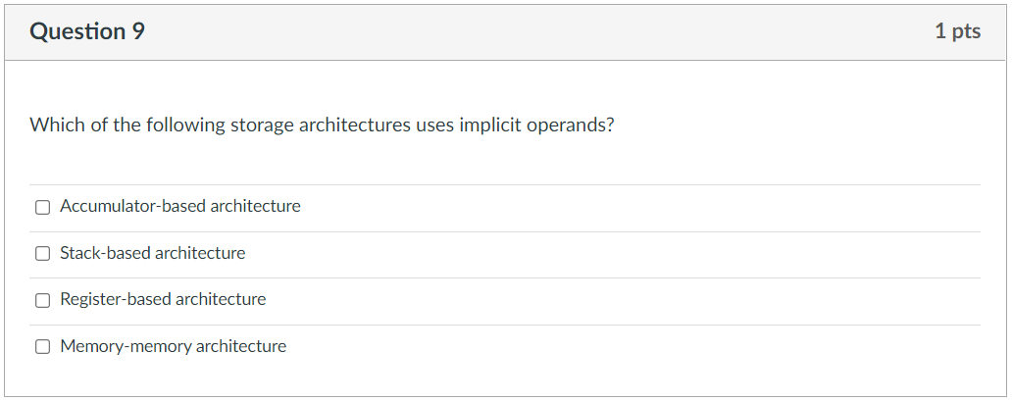

Week-4 MIPS

Slide 54
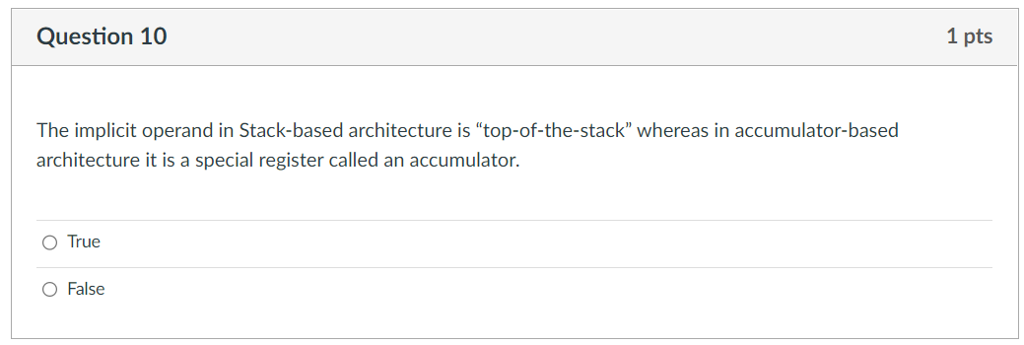
Week-4 MIPS

Slide 55

Mentimeter Quiz

Slide 56

Q0 (just for fun)
What does the abbreviation MIPS stand for?
A) Mega Instructions Per Second B) Many Integrated Processing Systems C) Microprocessor without Interlocked Pipeline Stages D) Millions of Instructions Per Second
E) Multiple Instructions Per Second
Notes:
Correct Answer: C) Microprocessor without Interlocked Pipeline Stages
Explanation:
Many people think MIPS stands for "Millions of Instructions Per Second" (Option D), which is actually a performance metric, not the name of the architecture.
The actual meaning of MIPS refers to how it is designed: Microprocessor without Interlocked Pipeline Stages, which improves speed by simplifying instruction handling.

Slide 57
Q1
A MIPS jump instruction is encoded in a 32‑bit word with a 6‑bit opcode and a 26‑bit target address field. To compute the full 32‑bit jump target address, the 26‑bit field is first shifted left by ____ bits and then concatenated with the upper ____ bits of (PC + 4).
A) 2, 2
B) 4, 4
C) 4, 2
D) 2, 4
Notes:
In MIPS, immediate operands for addi instruction is typically 16-bit 2s Complement signed integers (used in instructions like addi, andi, ori, etc.), meaning they range from -32,768 to 32,767.
-2^15 to 2^15-1

Slide 58
Q2
In MIPS, R-type instructions are uniquely identified by the funct field. Based on this, how many unique R-type instructions can theoretically be defined?
A) 16 B) 32 C) 64 D) 128
Notes:
In MIPS, the R-type instruction has 6-bits function code – 2^6 = 64 possible instructions.

Slide 59

Q3
In the given MIPS code, what is the encoded offset value for the label End in the instruction beq $9, $0, End?
Loop: beq $9, $0, End
add $8, $8, $10
addi $9, $9, -1
addi $10, $9, 1
sll $7, $10, 10
j Loop
End:
Options: A) 6 B) 5 C) 4 D) 3

Slide 60
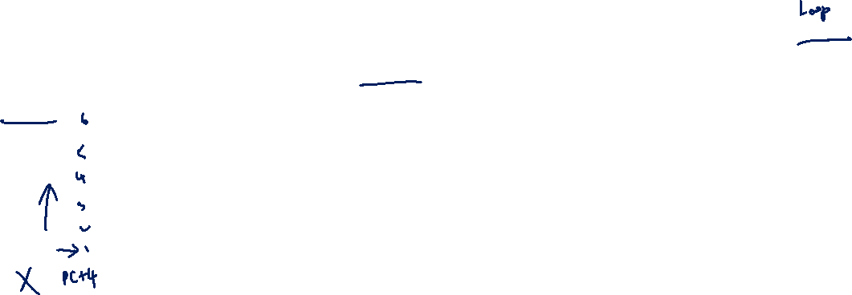
Q4
In the given MIPS code, what is the encoded offset value for the label End in the instruction beq $7, $0, Loop?
Loop: add $8, $8, $10
addi $9, $9, -1
addi $10, $9, 1
sll $7, $10, 10
sub $7, $10, $9
beq $7, $0, Loop
End:
Options: A) 6 B) 5 C) -5 D) -6

Slide 61

Q5
In the following MIPS code, the instruction j Loop is located at address 0x00001014, and the label Loop is at 0x00001000. What is the target address that is used to encode the jump instruction?
Loop: beq $9, $0, End # Address: 0x00001000
add $8, $8, $10 # Address: 0x00001004
addi $9, $9, -1 # Address: 0x00001008
addi $10, $9, 1 # Address: 0x0000100C
sll $7, $10, 10 # Address: 0x00001010
j Loop # Address: 0x00001014
End: # Address: 0x00001018
Options: A) 0x00001000 B) 0x00001014 C) 0x00000400 D) 0x00004000

Slide 62
Q6
Which of the following correctly describes the addressing mode used by branch and jump instructions in MIPS?
A) Both branch and jump instructions use PC-relative addressing. B) Branch instructions use PC-relative addressing, while jump instructions use absolute addressing within the same 256MB region. C) Branch instructions use absolute addressing, while jump instructions use PC-relative addressing within the same 256MB region. D) Both branch and jump instructions use absolute addressing within the full 32-bit address space.

Slide 63
Q7
How did we do this week? Any suggestions/comments?

Slide 64
End of File

